Slide 1
SUB QUERY CONSTRUCTION
Dissect the question.
Identify a query that answers a part of question.
Figure out how to link the two.
Add the where clause to link the two.

Slide 2
A SUBQUERY AS A SELECT COLUMN
STUDENT_DETAILS(Name, roll_no, location, phone_number)
STUDENT(Name, roll_no, section)
Q1) Display Name, location, phone_number of the students from STUDENT_DETAILS table whose section is A.
A1) select Name, location, phone_number from STUDENT_DETAILS where roll_no in (select roll_no from STUDENT where Section=‘A’);

Slide 3
INNER AND OUTER QUERY
A subquery is also called an inner query or inner select.
The statement containing a subquery is also called an outer query or outer select.
The inner query executes first before its parent query so that the results of an inner query can be passed to the outer query.

Slide 4
NON-CORRELATED SUBQUERIES
In non-correlated subquery, inner query doesn't depend on outer query and can run as stand alone query.
In non-correlated subquery inner query executes before outer query.
Subquery used along-with IN or NOT IN sql clause is good examples of Non-correlated subquery in SQL.
Non-correlated subqueries are faster than correlated subqueries.

Slide 5
CORRELATED SUBQUERIES
In correlated subquery, inner query depends on outer query.
In correlated subquery outer query executes before inner query.
Common example of correlated subquery is using exits and not exists keyword.
Correlated subqueries are slower than non-correlated subqueries.

Slide 6
Example of non-correlated and correlated subquery
Stock Table Market Table
RIC | COMPANY | LISTED_ON_ EXCHANGE
16578 | Sony | T
GOOG. | Google Inc. | O
GS.N | Goldman Group | N
INDIGO | Indigo airlines | NULL
INFY.BO | Infosys | BO
VOD.L | Vodafone group | L
RIC | NAME | COUNTRY
T | Tokyo stock exchange | Japan
O | NASDAQ | United States
N | New York stock exchange | United States
BO | Bombay stock exchange | India

Slide 7
NON-CORRELATED:
Find all stocks from Japan.
SELECT COMPANY FROM Stock WHERE LISTED_ON_EXCHANGE = (SELECT RIC FROM Market WHERE COUNTRY='Japan');
Find all stocks from United States and India.
SELECT COMPANY FROM Stock WHERE LISTED_ON_EXCHANGE IN (SELECT RIC FROM Market WHERE COUNTRY='United States' OR COUNTRY= 'India');

Slide 8
CORRELATED
Return all markets which has at least one stock listed on it.
SELECT m.NAME FROM Market m WHERE m.RIC = (SELECT s.LISTED_ON_EXCHANGE FROM Stock s WHERE s.LISTED_ON_EXCHANGE=m.RIC);

Slide 9
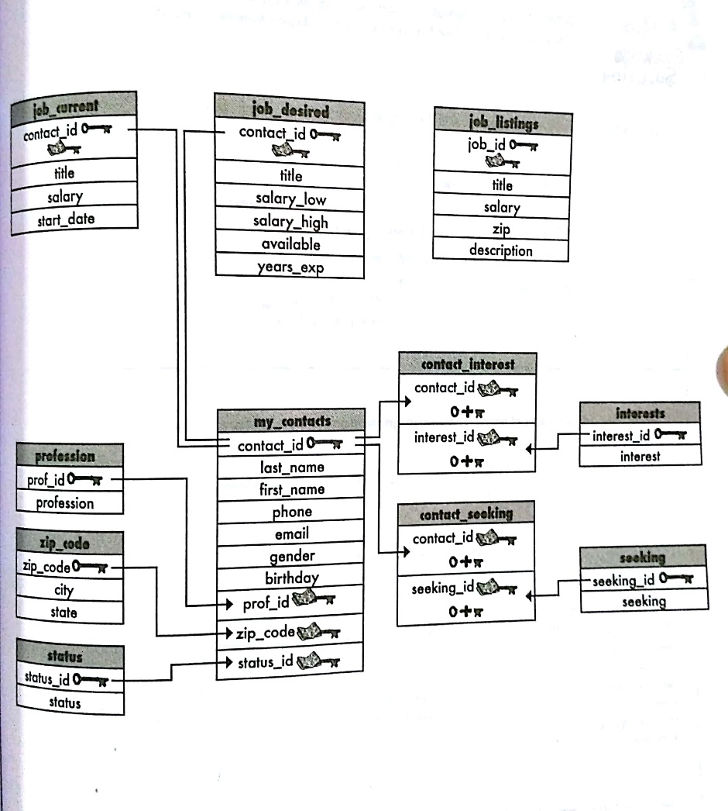

Slide 10
Write a query to get the average salary of a web developer from the job_current table.
Write a query to get the first name, last name and salary of all web developers in the job_current table.
List titles for jobs that earn salaries equal to the highest salary in the job_listings table.
List the first and last name of people with a salary greater than the average salary.

